Slide 1
Graphene Devices for Beyond-CMOS Heterogeneous Integration
Mohamed Darwish
Notes:
Good morning everyone. Mention name and Advisor. Welcome to my PhD Defense.

Slide 2
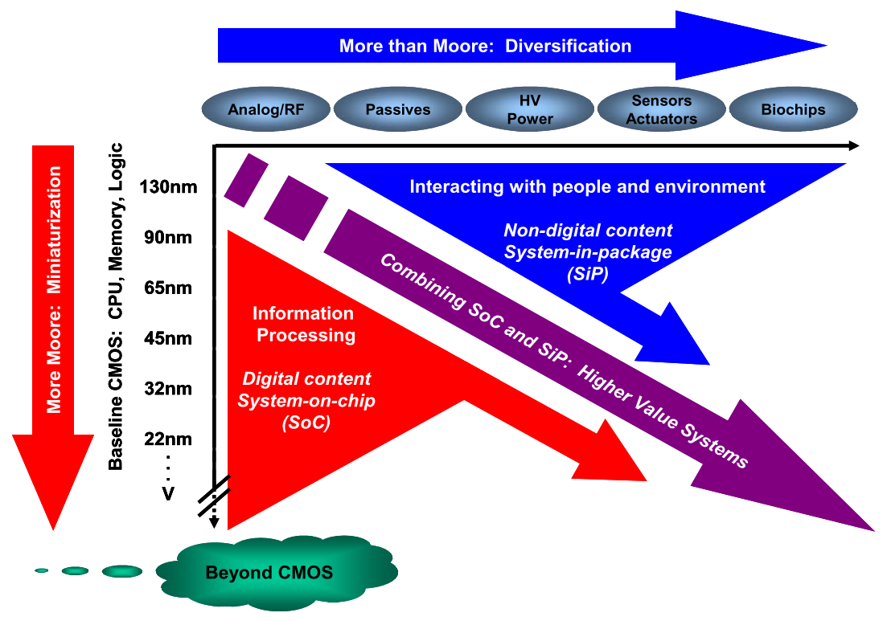
What’s next on the Roadmap?
Introduction
Graphene CNN
Low-loss Diode
Diffusive Coupler
Tech. Limitations
Future Work
W. Arden, M. Brillouët, P. Cogez, M. Graef, B. Huizing, and R. Mahnkopf, “‘More-than-Moore’ White Paper.”
Notes:
Since its early days, the semiconductor industry’s economics relied on reducing the cost per function on chip, while fixing the cost per unit chip area, reducing the overall cost per function and allowing the integration of more functions for the same cost. This methodology paved the way for the versatile use of electronic components and moving them from a nice, high-end, low-volume market to high-volume consumer electronics. Historically, the reduction in cost per function was done by using clever circuit techniques and reducing the size of electronic components (scaling), which is what we know now as Moore’s law. The scaling trend is what we call now More Moore.
As the economic revenues of scaling started to wind down due to the increasing cost of new manufacturing tools, masks and the adverse impact of scaling on device performance, new techniques have been proposed to get over the scaling obstacles. In that sense, two more techniques were proposed to continue the reduction of cost per chip-integrated function: More-than-Moore and Beyond-CMOS.
Moore-than-Moore focuses on the integration of more circuit components on-chip, such as Analog circuits, Sensors and MEMS. Beyond-CMOS focuses on the integration of new materials with Silicon, the current workhorse material of the electronics industry, such as SiGe, III-V Semiconductors and 2D materials. In this work, we focus on the use of graphene with Silicon, or in other words, using graphene for beyond-CMOS heterogeneous integration,.

Slide 3
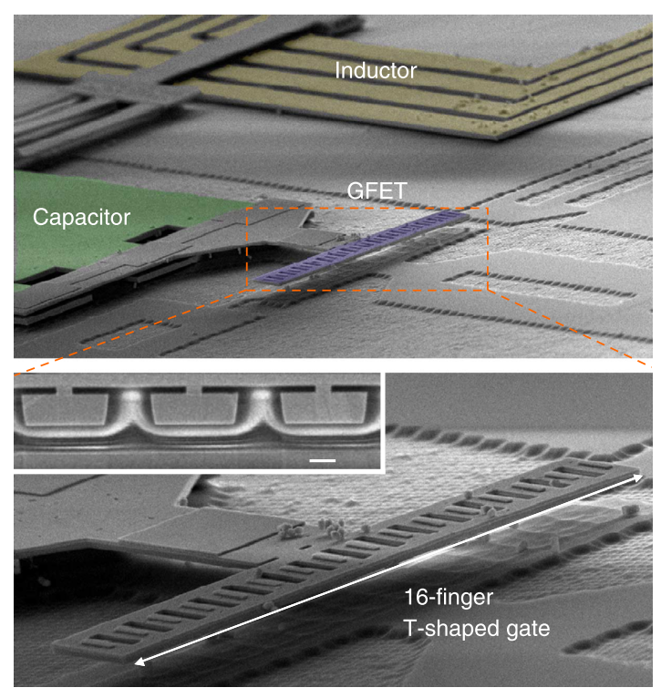
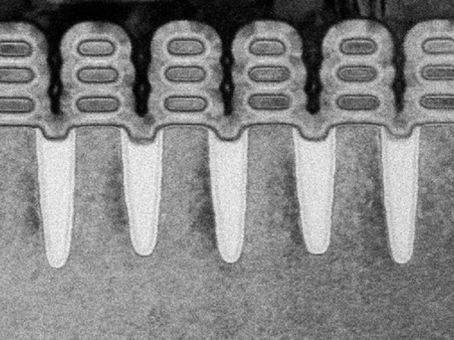
Beyond-CMOS, More Moore and More than Moore
Introduction
Graphene CNN
Low-loss Diode
Diffusive Coupler
Tech. Limitations
Future Work
IBM
S.-J. Han, A. V. Garcia, S. Oida, K. A. Jenkins, and W. Haensch, “Graphene radio frequency receiver integrated circuit,” Nat. Commun., vol. 5, pp. 1–6, Jan. 2014.
Notes:
Examples of all these trends can be found in the work published recently. The figure on the left shows the integration of inductors and capacitors on chip (Moore-than-More), with graphene channel transistors (beyond-CMOS), demonstrating the first functional graphene radio.
An example on More-Moore, is the 5 nm, GAA Silicon Nanoribbon transistors, which uses silicon nanoribbons surrounded by gates from all the directions to enable the fabrication of deeply scaled silicon transistors down to 5 nm.

Slide 4
New Architecture and Device Paradigms
Introduction
Graphene CNN
Low-loss Diode
Diffusive Coupler
Tech. Limitations
Future Work
Architecture
Quantum
Neuromorphic
Information Processing
Device-Aware Synthesizers
Stochastic Computing
Error-Prone Computing
Device
2D FET
CNT
Tunnel FET
Spintronic
GpnJ
Magnetic
Notes:
An aspect that people usually overlook when discussing scaling is the impact of clever circuit architectures and techniques in reducing the overall cost per function. Now, people have been looking back at that, investigating the different architecture-circuit-device co-optimization and design, to enable the integration of more area and power efficient functions, allowing us to reduce the overall cost and power-budget per function; an aspect crucial in today’s mobile and IOT-focused market.
An example of the new architecture trends is the use of brain-inspired or neuromorphic computing, quantum computing and error-prone computing to name a few.
In addition, new device architectures as 2D FETs, Tunnel FET and magnetic logic circuits are investigated as alternatives and additions to CMOS to allow further reduction in cost per function. However, these new design paradigms have been living in vacuum, without much collaboration, which has been the essence in top-down and bottom-up design approaches, that allow different levels of design abstraction to work independently.

Slide 5
We Need Paradigm Shifts
Introduction
Graphene CNN
Low-loss Diode
Diffusive Coupler
Tech. Limitations
Future Work
System Architecture
Module
Gate/Circuit
Device
System
Circuit
Device
Notes:
In this work, we show how a departure from the independent design abstraction paradigms into a collaborative device-circuit-system co-design allows us to fully-leverage the advantages of new materials. In this work, we will focus on the use of graphene in a non-transistor-centric way. We will focus on integrating functions into devices, where a device is designed to implement a high-level function, allowing considerable area and power savings.

Slide 6
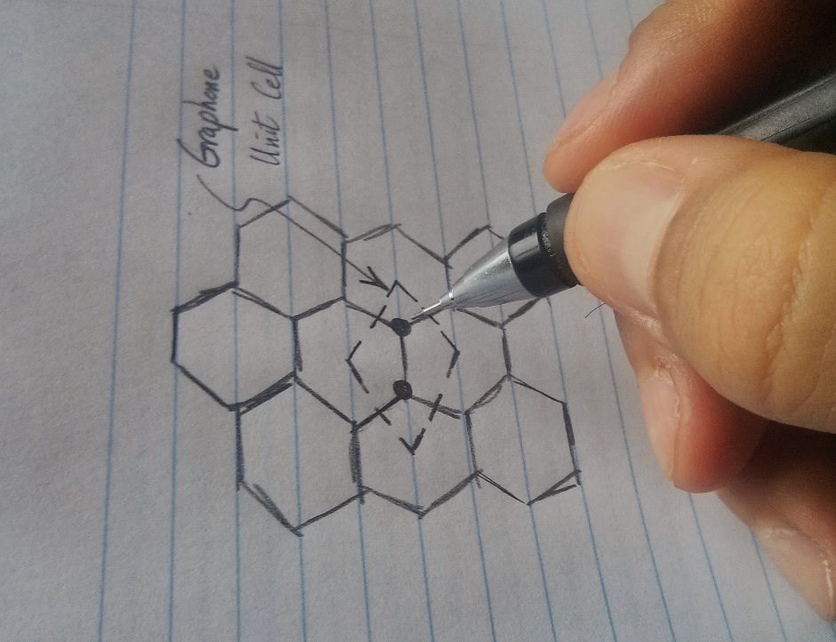
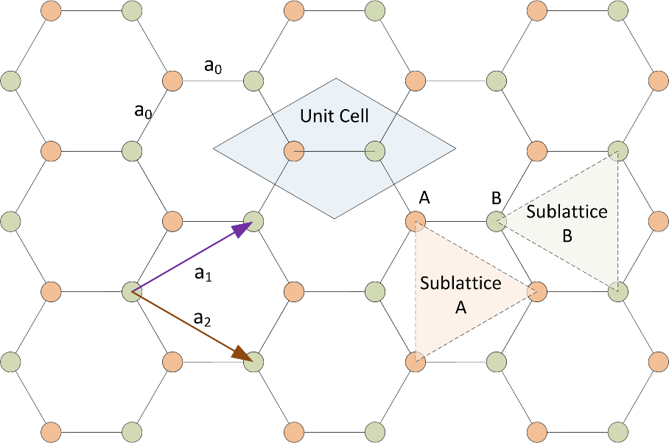
What is graphene?
Introduction
Graphene CNN
Low-loss Diode
Diffusive Coupler
Tech. Limitations
Future Work
1 layer of graphite = graphene
Notes:
Graphene is a single layer of carbon. For example, if you scribe a line with a pencil, this pencil line is made out of a graphite, which is composed of a huge number of graphene layers stacked all over each other. Each single layer of graphite is known as graphene.
The carbon atoms in graphene are placed in a hexagonal lattice as shown in the figure on the right. This lattice can be reconstructed using a two-atom unit cell using the two basis vectors shown. This peculiar placement of atoms gives graphene lots of unique properties.

Slide 7
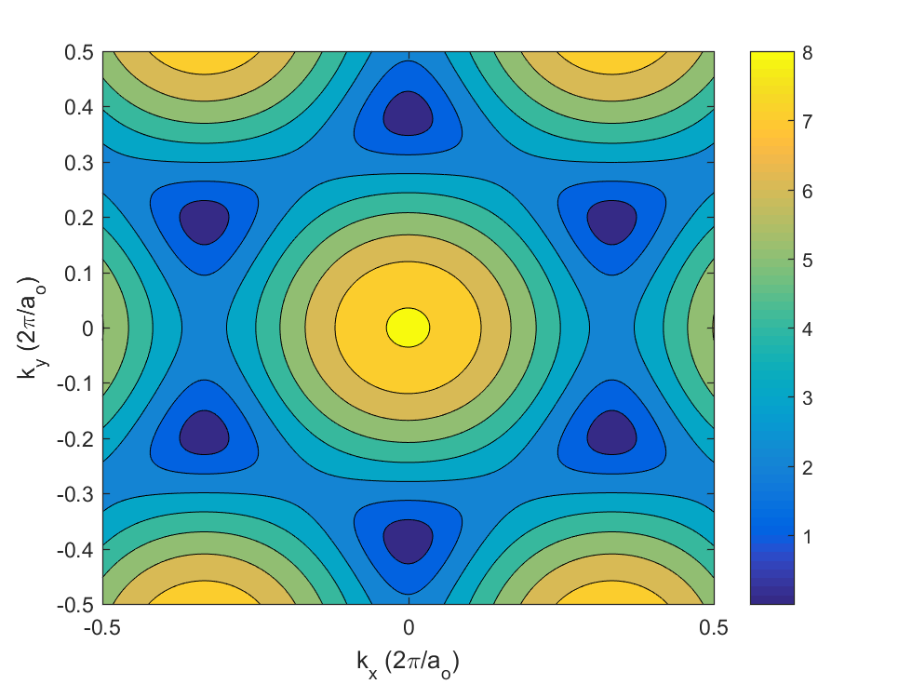
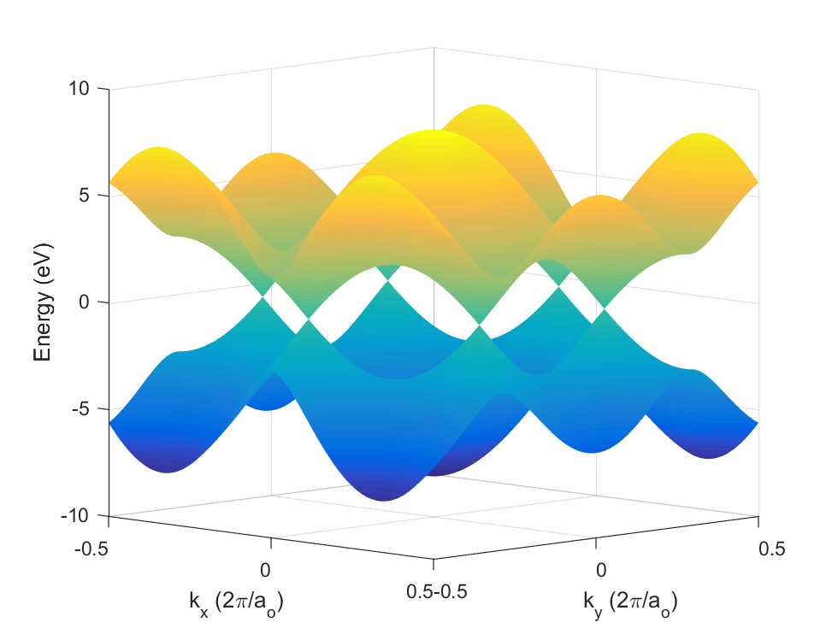
Graphene’s Band Structure
Introduction
Graphene CNN
Low-loss Diode
Diffusive Coupler
Tech. Limitations
Future Work
Notes:
Graphene’s electronic band structure has a hexagonal the Brillouin zone. The valence and conduction bands touch at vertices of the Brillouin zone hexagon corners. As such, graphene is a zero band-gap material, and is classified as a semimetal.

Slide 8
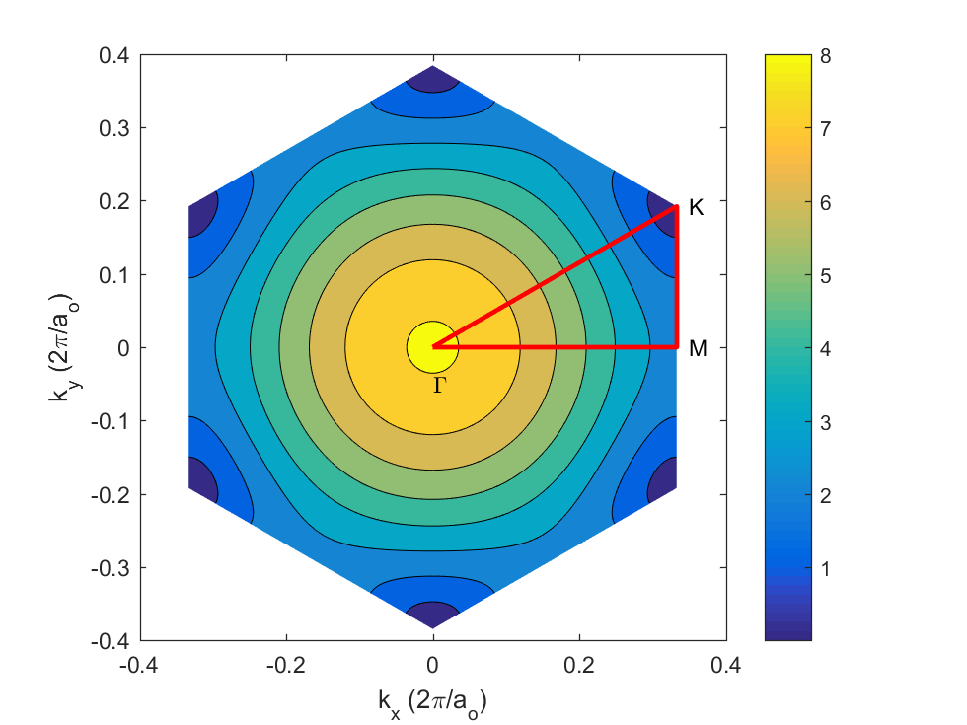
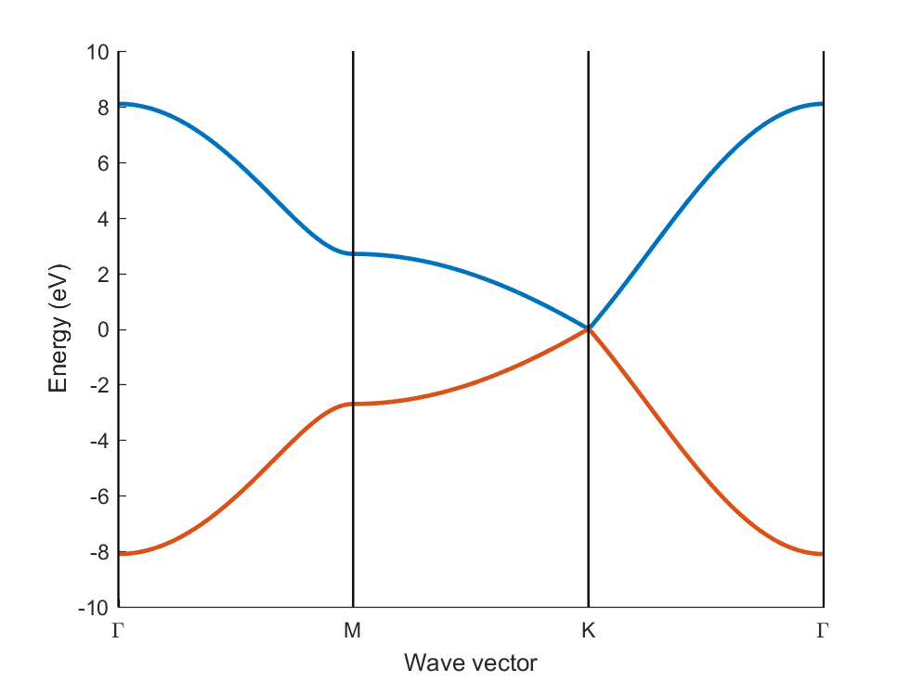
Graphene’s dispersion relation – High Symmetry Points
Introduction
Graphene CNN
Low-loss Diode
Diffusive Coupler
Tech. Limitations
Future Work
Most device operate in this range
Notes:
In addition to the 6 fold hexagonal symmetry, the graphene band structure has mirror symmetric around the normal to the Brillouin zone edges. As such, we can reconstruct the information in the Brillouin zone using the area defined by the high symmetry points ΓMK. The band structure along the high-symmetry point shows that the band structures touch at the corners, which are known as the Dirac points, where most electronic device operate (most devices operate around a Fermi energy of 1 eV from the zero band-gap).

Slide 9
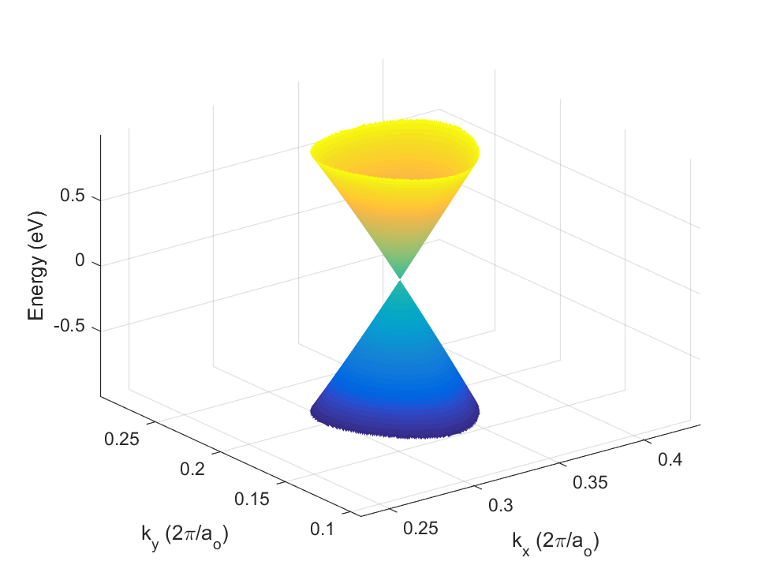
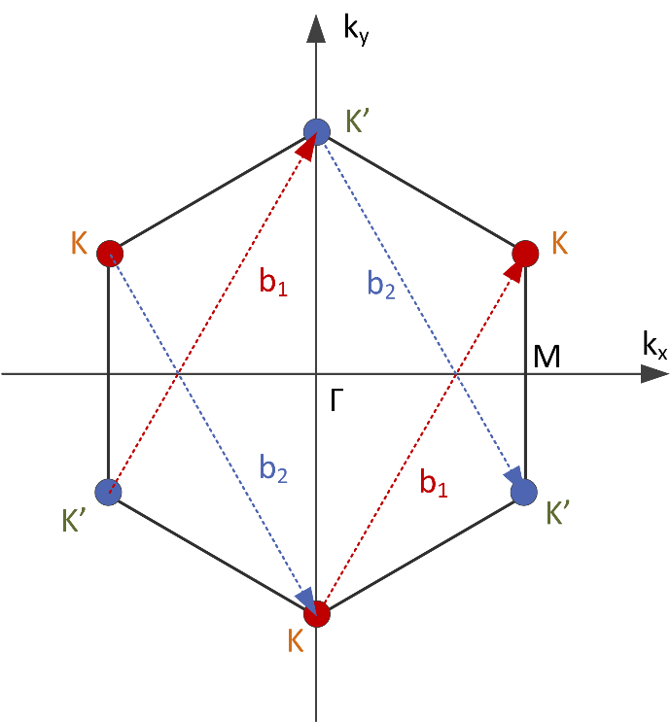
What’s special about the Dirac points?
Introduction
Graphene CNN
Low-loss Diode
Diffusive Coupler
Tech. Limitations
Future Work
Notes:
Interestingly, the band structure looks conical around the Dirac point, resembling the energy dispersion of relativistic massless particles (photons), with the positive and negative energy particles (or electrons and holes) having the same mass. This gives rise to the very interesting physics, as it means that charge carriers act like photons in this regime. They follow a Snell’s law like at interfaces between regions of different doping and move around with a fixed velocity (Fermi velocity). A point to note however, that the Dirac points are not all equivalent; any two cannot be connected using integral multiples of the reciprocal lattice basis, and are as such classified into two different groups (K and K’), containing the points that can be reached using integral multiple of the basis vectors.

Slide 10
Why graphene?
Introduction
Graphene CNN
Low-loss Diode
Diffusive Coupler
Tech. Limitations
Future Work
Unique electronic properties enabling novel devices beyond Transistors
Photon-like behavior of charge carriers
CVD growth allows wafer-scale coverage
CMOS Compatible
Notes:
These unique electronic properties of graphene make it very attractive when considering beyond-CMOS integration. In addition, the maturity and relative ease of fabrication wafer-scale graphene using CVD and its CMOS compatibility, make it a natural choice for wafer-scale beyond-CMOS integration.

Slide 11
Outline
Introduction
Graphene CNN
Low-loss Diode
Diffusive Coupler
Tech. Limitations
Future Work
All-Graphene Neuromorphic Computing
Low-loss Graphene Diodes
Current Coupling in Diffusive-Transport Graphene
Current Technological Limitations
Notes:
In what follows, we describe the use of graphene in a non-transistor-centric approach for different applications. We will present the use of graphene to build all-graphene neuromorphic or brain-like computers, discussing a new area-efficient architecture for brain-like computing that can be implemented using graphene.
We then preset the design of a low-loss diode using graphene, for the realization of mux-based logic families and low-loss energy scavenging elements. We show how the photon-like behavior of charge carriers in graphene can be harnessed to create asymmetrical conduction.
We then investigate the limits of scaling CVD graphene interconnects by studying the coupling between graphene ribbons operating in the diffusive-transport regime, showing that graphene interconnects are deeply scalable without.
We conclude by a discussion of the current technological limitations and information we have gathered when fabricating graphene devices, shedding light on some very interesting properties of graphene.

Slide 12
Outline
Introduction
Graphene CNN
Low-loss Diode
Diffusive Coupler
Tech. Limitations
Future Work
All-Graphene Neuromorphic Computing
Low-loss Graphene Diodes
Current Coupling in Diffusive-Transport Graphene
Current Technological Limitations

Slide 13
Neuromorphic computing using CNNs
Introduction
Graphene CNN
Low-loss Diode
Diffusive Coupler
Tech. Limitations
Future Work
Neural Networks have been very successful in classification and image processing problems
One circuit-friendly implementation (Cellular Neural Networks) have been around since the 1980s
CMOS CNN implementation are size limited
L. O. Chua and L. Yang, “Cellular neural networks: theory,” IEEE Trans. Circuits Syst., vol. 35, no. 10, pp. 1257–1272, 1988.

Slide 14
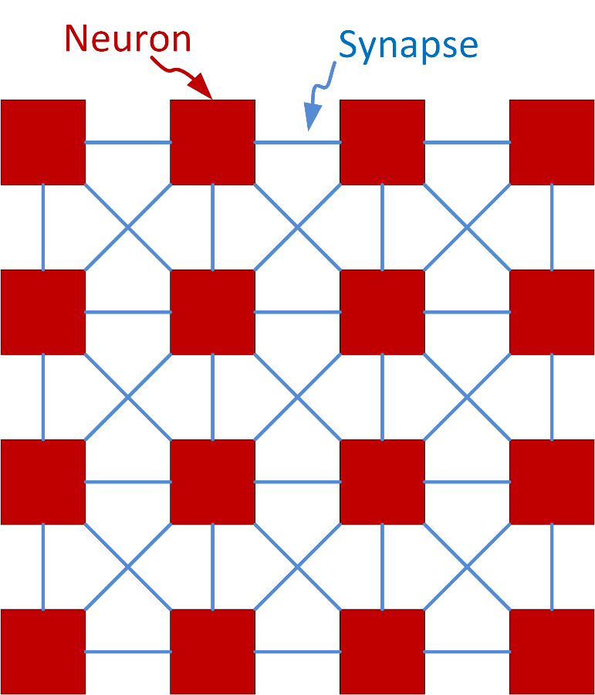
Cellular Neural Networks - Architecture
Introduction
Graphene CNN
Low-loss Diode
Diffusive Coupler
Tech. Limitations
Future Work
4x4 CNN
L. O. Chua and L. Yang, “Cellular neural networks: theory,” IEEE Trans. Circuits Syst., vol. 35, no. 10, pp. 1257–1272, 1988.

Slide 15
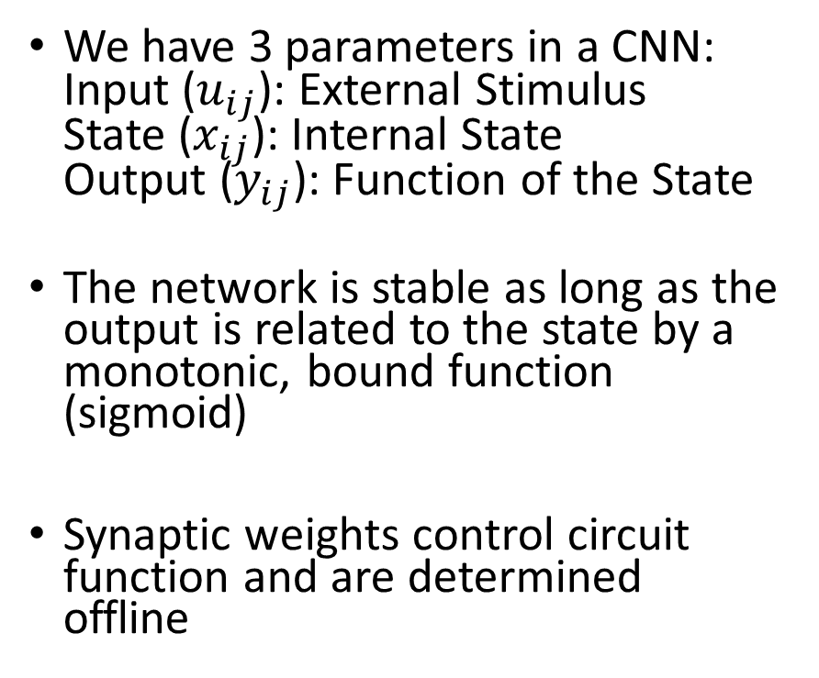
Cellular Neural Networks – System Model
Introduction
Graphene CNN
Low-loss Diode
Diffusive Coupler
Tech. Limitations
Future Work
We have 3 parameters in a CNN: Input ($u_{ij}$): External Stimulus State ($x_{ij}$): Internal State Output ($y_{ij}$): Function of the State
The network is stable as long as the output is related to the state by a monotonic, bound function (sigmoid)
Synaptic weights control circuit function and are determined offline
L. O. Chua and L. Yang, “Cellular neural networks: theory,” IEEE Trans. Circuits Syst., vol. 35, no. 10, pp. 1257–1272, 1988.

Slide 16
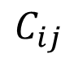
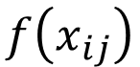
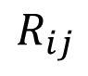
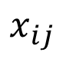
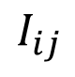
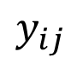
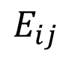
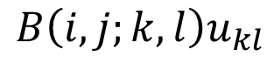
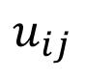
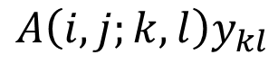
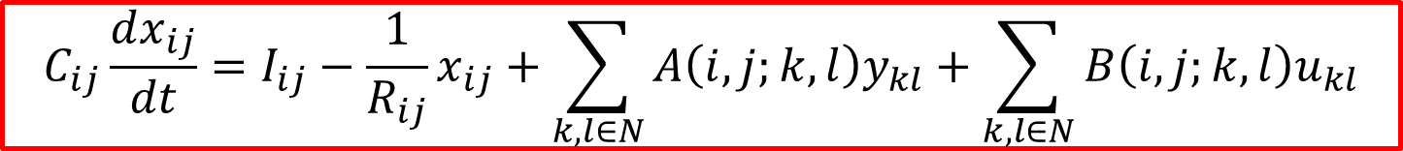
Cellular Neural Networks – Neuron Circuit Model
Introduction
Graphene CNN
Low-loss Diode
Diffusive Coupler
Tech. Limitations
Future Work
$$u_{ij}$$
$$x_{ij}$$
$$y_{ij}$$
$$A\left(i,j;k,l\right)y_{kl}$$
$$B\left(i,j;k,l\right)u_{kl}$$
$$f\left(x_{ij}\right)$$
$$E_{ij}$$
$$I_{ij}$$
$$R_{ij}$$
$$C_{ij}$$
Input
Stimulus
State Variable
Output Sigmoid
$$C_{ij}\frac{dx_{ij}}{dt}=I_{ij}−\frac{1}{R_{ij}}x_{ij}+\sum_{k,l∈N}{A\left(i,j;k,l\right)y_{kl}}+\sum_{k,l∈N}{B\left(i,j;k,l\right)u_{kl}}$$
L. O. Chua and L. Yang, “Cellular neural networks: theory,” IEEE Trans. Circuits Syst., vol. 35, no. 10, pp. 1257–1272, 1988.
Notes:
Canonical CNN implementations is suitable for CMOS
Several Analog implementations available
Nonlinearity not a problem as long as its monotonic
Synaptic weights implemented using transconductors
Need to be tunable with good matching
Sets a lower bound on the current consumption ($g_{m}∝I$)
Number of Synapses >> Number of Neurons
Neuron RC controls system dynamics and speed
Neuron C >> Parasitic Capacitance for reliable operation
R not too big to reduce the noise in the system, but $P∝1/R$

Slide 17
Problems of CMOS CNN
Introduction
Graphene CNN
Low-loss Diode
Diffusive Coupler
Tech. Limitations
Future Work
Power Consumption
Dominated by Synapse Transconductors
Large number of Synapses
Matching and Tuning Requirements
Synapse Transconductance needs to be tunable
Synapses must be well matched
Speed Limitations
Neuron C >> Parasitics for Robustness
Lower RC means more power consumption

Slide 18
What can graphene do?
Introduction
Graphene CNN
Low-loss Diode
Diffusive Coupler
Tech. Limitations
Future Work
Graphene provides variable, finite channel resistance
Voltage controlled resistor or low output resistance transistor
CVD graphene allow us to create a large number of devices
Graphene is compatible with CMOS
Allows leveraging the high memory density available in CMOS

Slide 19
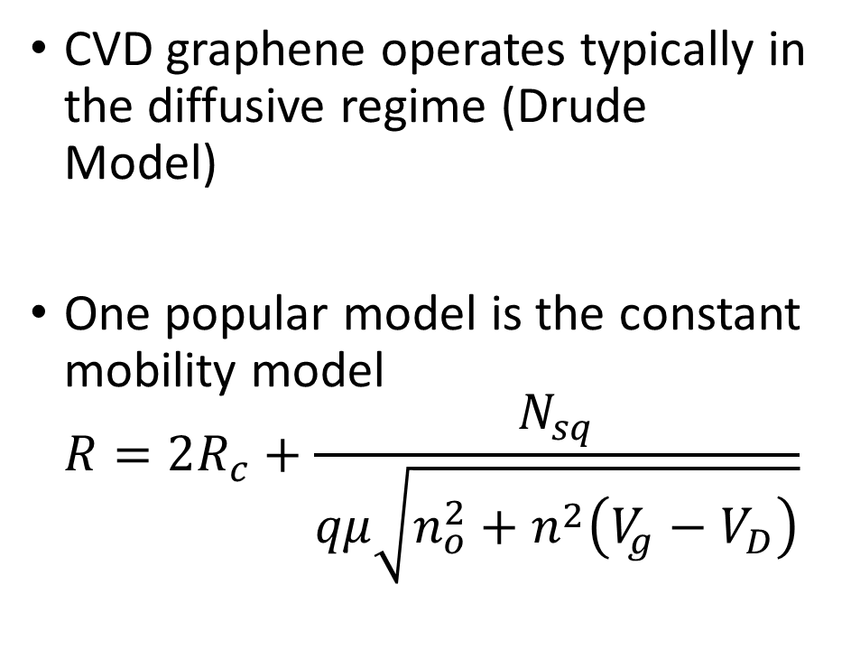
Graphene Resistance vs Gate Voltage
Introduction
Graphene CNN
Low-loss Diode
Diffusive Coupler
Tech. Limitations
Future Work
CVD graphene operates typically in the diffusive regime (Drude Model)
One popular model is the constant mobility model $R=2R_{c}+\frac{N_{sq}}{qμ\sqrt{n_{o}^{2}+n^{2}\left(V_{g}−V_{D}\right)}}$

Slide 20
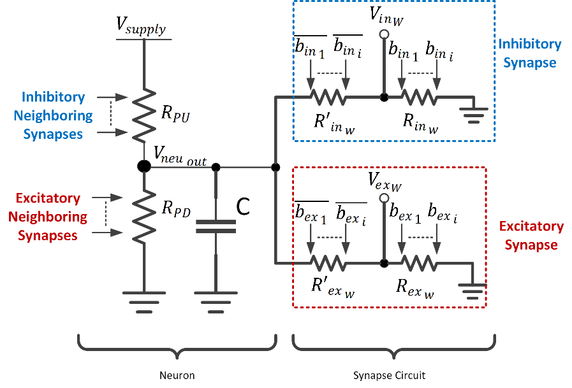
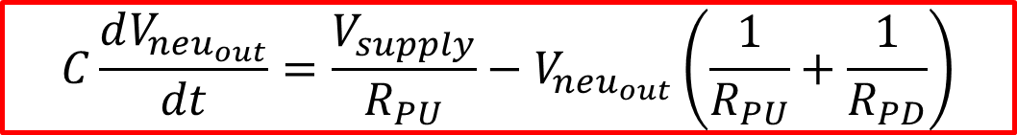
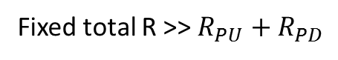
All-Graphene CNN - Architecture
Introduction
Graphene CNN
Low-loss Diode
Diffusive Coupler
Tech. Limitations
Future Work
Fixed total R >> $R_{PU}+R_{PD}$
$$C\frac{dV_{neu_{out}}}{dt}=\frac{V_{supply}}{R_{PU}}−V_{neu_{out}}\left(\frac{1}{R_{PU}}+\frac{1}{R_{PD}}\right)$$
M. Darwish, V. Calayir, L. Pileggi, and J. A. Weldon, “Ultracompact Graphene Multigate Variable Resistor for Neuromorphic Computing,” IEEE Trans. Nanotechnol., vol. 15, no. 2, pp. 318–327, Mar. 2016.
Notes:
Neurons formed by a string of two voltage controlled resistors
Inhibitory/Excitatory resistors pull towards ground/supply respectively
Neuron Capacitor stores the state
Synapses formed via two complementary digitally-controlled resistors
Scales the output of the neuron before applying it to the inhibitory/excitatory control of the neighbor neuron
Both neurons and synapses formed via dual-gates graphene FETs

Slide 21
All-Graphene CNN – Architecture Properties
Introduction
Graphene CNN
Low-loss Diode
Diffusive Coupler
Tech. Limitations
Future Work
Pros
Cons
Implicit sigmoidal behavior.
Synapse power consumption can be made arbitrarily small.
Reduced parasitic capacitance at state variable node.
Synapse matching required locally not globally.
Neuron RC limits speed.
More complicated training.
Network size limited by gate strength.

Slide 22
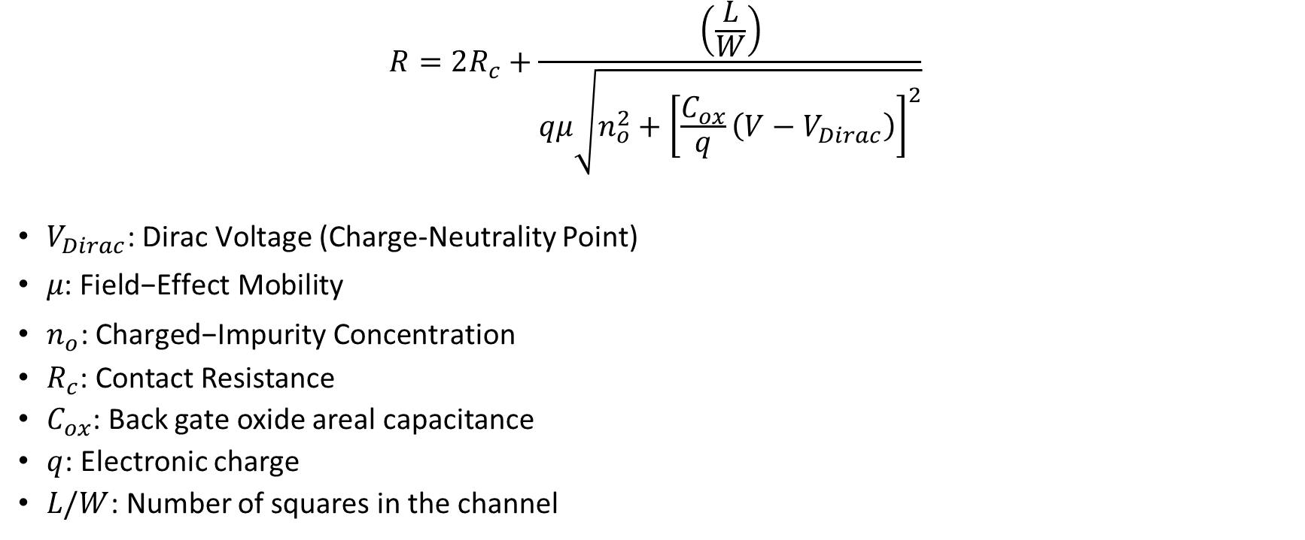
Constant Mobility Model
Introduction
Graphene CNN
Low-loss Diode
Diffusive Coupler
Tech. Limitations
Future Work
$$R=2R_{c}+\frac{\left(\frac{L}{W}\right)}{qμ\sqrt{n_{o}^{2}+{\left[\frac{C_{ox}}{q}\left(V−V_{Dirac}\right)\right]}^{2}}}$$
$V_{Dirac}\text{: }\text{Dirac} \text{Voltage}$ (Charge-Neutrality Point)
$μ\text{: }\text{Field}\text{−}\text{Effect} \text{Mobility}$
$n_{o}\text{: }\text{Charged}\text{−}\text{Impurity} \text{Concentration}$
$R_{c}$: Contact Resistance
$C_{ox}$: Back gate oxide areal capacitance
$q$: Electronic charge
$L/W$: Number of squares in the channel
S. Kim, J. Nah, I. Jo, D. Shahrjerdi, L. Colombo, Z. Yao, E. Tutuc, and S. K. Banerjee, “Realization of a high mobility dual-gated graphene field-effect transistor with Al2O3 dielectric,” Appl. Phys. Lett., vol. 94, no. 6, p. 62107, 2009.

Slide 23
Neuron/Synapse: Device Structure
Introduction
Graphene CNN
Low-loss Diode
Diffusive Coupler
Tech. Limitations
Future Work
$$R\left(V_{1},V_{2},…,V_{n},V_{bg}\right)=ρ\left(V_{bg}\right)\frac{L_{u}}{W_{u}}+\sum_{i=1 }^{n}{ρ\left(V_{i},V_{bg}\right)\frac{L_{i}}{W}+\frac{R_{T}\left(V_{i},V_{bg}\right)}{W}}$$
M. Darwish, V. Calayir, L. Pileggi, and J. A. Weldon, “Ultracompact Graphene Multigate Variable Resistor for Neuromorphic Computing,” IEEE Trans. Nanotechnol., vol. 15, no. 2, pp. 318–327, Mar. 2016.
Notes:
Back gate used to bias the device and top gates used to change the resistance.

Slide 24
Notable Fabrication Details
Introduction
Graphene CNN
Low-loss Diode
Diffusive Coupler
Tech. Limitations
Future Work
Contacts cannot be sputtered to prevent damage to graphene
Evaporation causes no kinetic impact damage unlike sputtering
Top gate oxide require a seed as non-functionalized ALD precursors do not react with the graphene surface and preferentially react with reactive graphene edges
Top gate oxide ALD relieves stress developed during contacting, etching and seed layer deposition (more on this later)

Slide 25
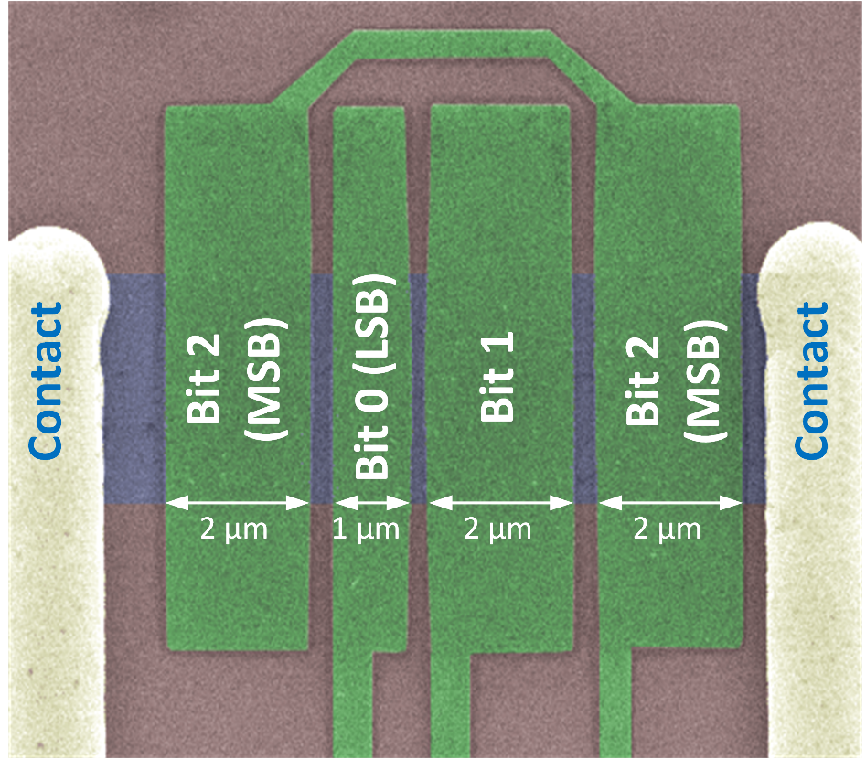
Neuron/Synapse: How they look like
Introduction
Graphene CNN
Low-loss Diode
Diffusive Coupler
Tech. Limitations
Future Work
3-input Neuron
3-bit Synapse

Slide 26
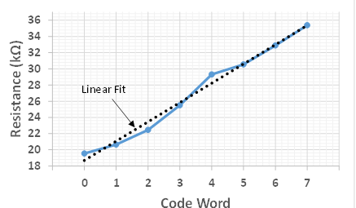
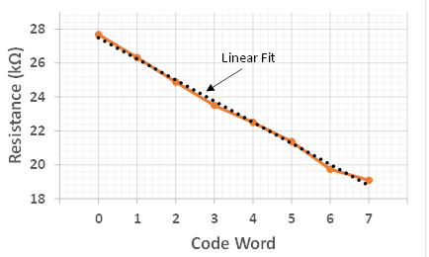
Interesting Synapse Behavior
Introduction
Graphene CNN
Low-loss Diode
Diffusive Coupler
Tech. Limitations
Future Work
V_{BG}>V_{D}
V_{BG}<V_{D}

Slide 27
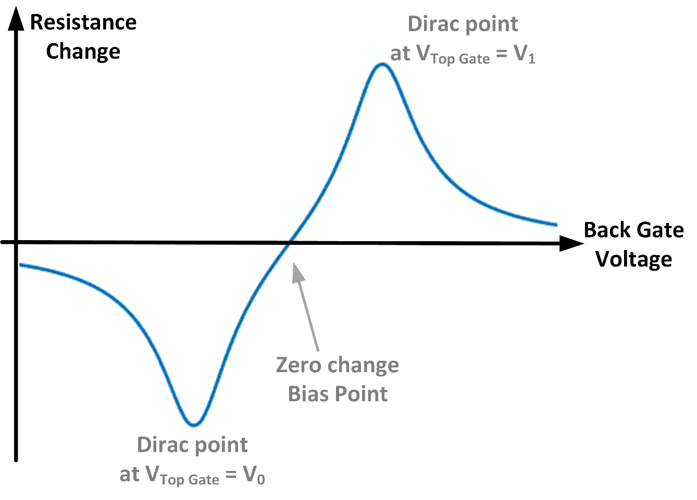
Synapse as Dual-Slope Digital-to-Resistance Converter
Introduction
Graphene CNN
Low-loss Diode
Diffusive Coupler
Tech. Limitations
Future Work

Slide 28

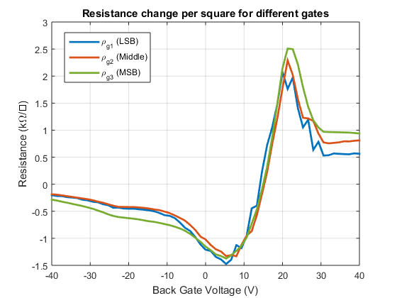
Measured Synapse Resistance Change
Introduction
Graphene CNN
Low-loss Diode
Diffusive Coupler
Tech. Limitations
Future Work
Expected
Measured

Slide 29
Synapses as Digital-to-Resistance Converter
Introduction
Graphene CNN
Low-loss Diode
Diffusive Coupler
Tech. Limitations
Future Work
Synapses act as Digital-to-Resistance Converter
Slope and magnitude of resistance change controlled by back gate voltage
Process variability reduced using CMOS-like techniques (ex. Common centroid)

Slide 30
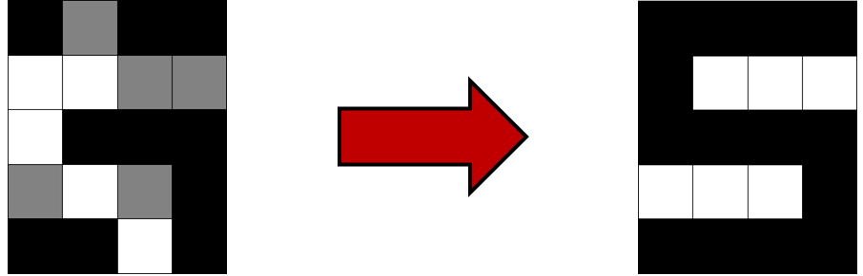
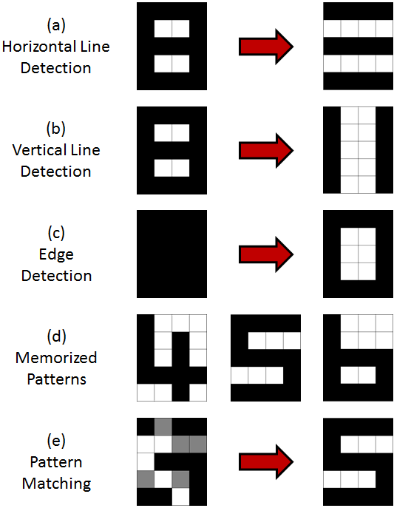
System-Level VerilogA Simulation
Introduction
Graphene CNN
Low-loss Diode
Diffusive Coupler
Tech. Limitations
Future Work
VerilogA models developed based on measurement results
Classification trained using Hebbian learning offline and successful up to 28% distortion
System can also perform edge and line detection

Slide 31
Conclusion
Introduction
Graphene CNN
Low-loss Diode
Diffusive Coupler
Tech. Limitations
Future Work
System-Circuit-Device co-design enable multi-level innovations
New architecture relaxes chip-level matching constraints
Graphene enables area-efficient implementation of synapses and neurons
Graphene synapses are compact digital-to-resistance converters

Slide 32
Outline
Introduction
Graphene CNN
Low-loss Diode
Diffusive Coupler
Tech. Limitations
Future Work
All-Graphene Neuromorphic Computing
Low-loss Graphene Diodes
Current Coupling in Diffusive-Transport Graphene
Current Technological Limitations

Slide 33
A review of graphene diodes
Introduction
Graphene CNN
Low-loss Diode
Diffusive Coupler
Tech. Limitations
Future Work
Linear dispersion and continuum of states except at the Dirac point make graphene diodes attractive
Lossless as there is no potential barrier across PN junctions
Relies on optics-inspired techniques for conduction anisotropy
Can be used for low-loss scavenging of RF power or diode-based mux logic
Graphene MUX via two controlled back-to-back diodes
Characterized via the asymmetry [A = I(V_{FWD})/I(V_{BWD})]

Slide 34
Geometric Graphene Diodes
Introduction
Graphene CNN
Low-loss Diode
Diffusive Coupler
Tech. Limitations
Future Work
Geometric diodes proposed to achieve asymmetric conduction by collimation of charge carriers in one direction and not the other
Fabricated using exfoliated and CVD graphene
Exfoliated graphene devices always had higher asymmetry
Hints to the role of scattering
Maximum achieved asymmetry was ~1.37 using exfoliated graphene

Slide 35
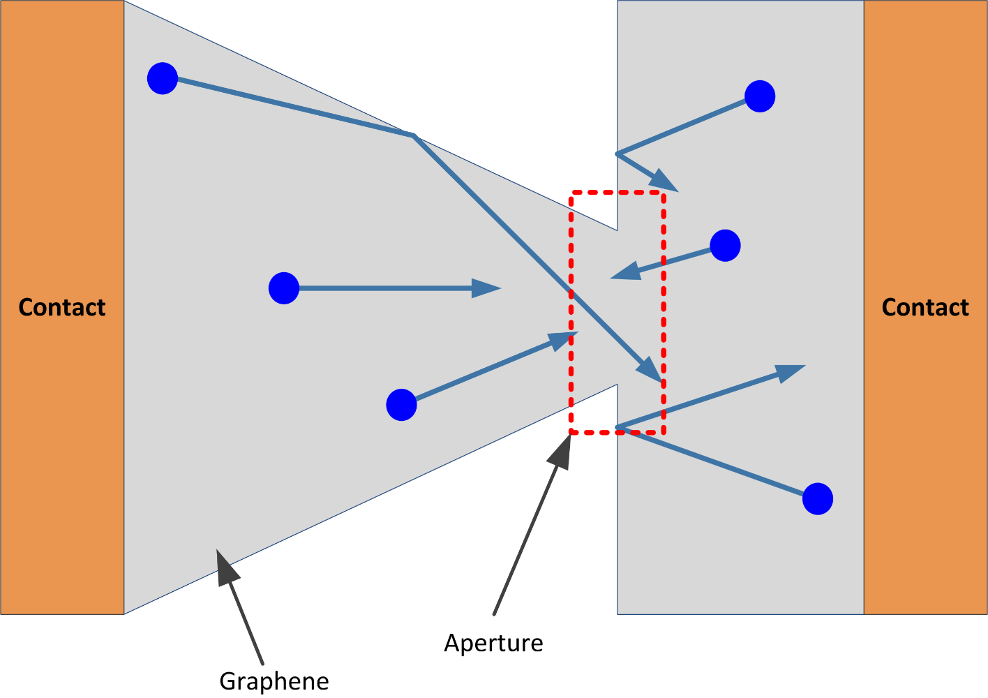
Principle of operation of geometric diodes
Introduction
Graphene CNN
Low-loss Diode
Diffusive Coupler
Tech. Limitations
Future Work

Slide 36
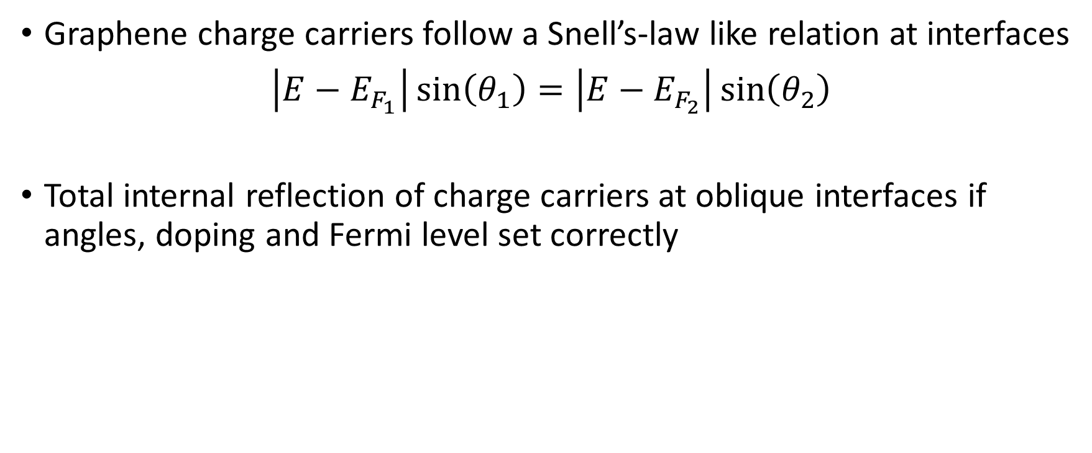
Oblique Incidence Graphene Diodes
Introduction
Graphene CNN
Low-loss Diode
Diffusive Coupler
Tech. Limitations
Future Work
Graphene charge carriers follow a Snell’s-law like relation at interfaces
$\left|E−E_{F_{1}}\right|\sin\left(θ_{1}\right)=\left|E−E_{F_{2}}\right|\sin\left(θ_{2}\right)$
Total internal reflection of charge carriers at oblique interfaces if angles, doping and Fermi level set correctly

Slide 37
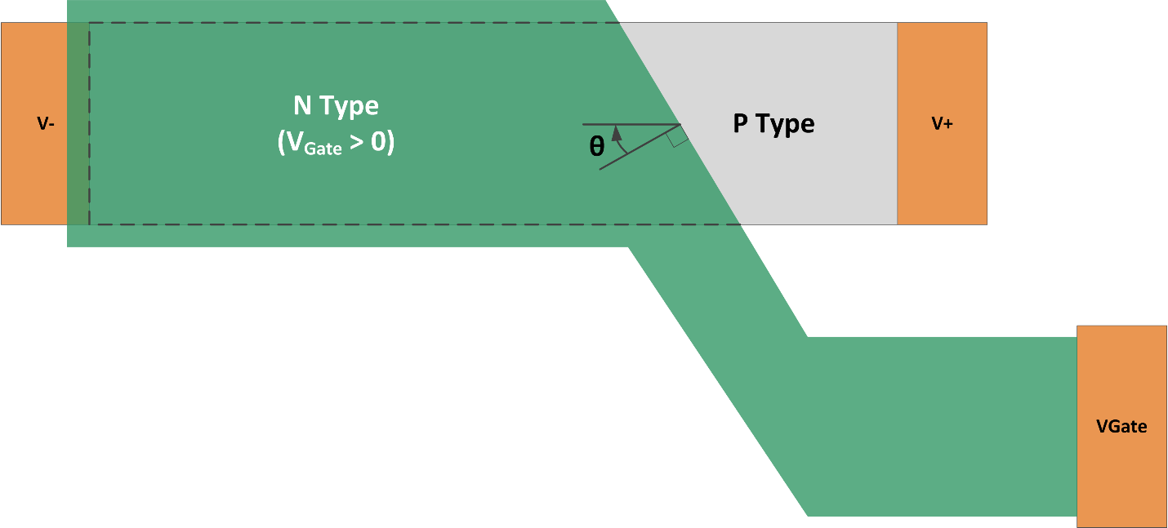
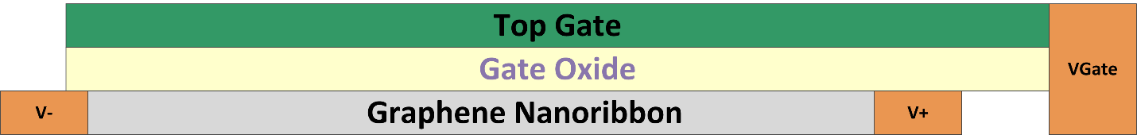
Proposed Oblique Incidence diode
Introduction
Graphene CNN
Low-loss Diode
Diffusive Coupler
Tech. Limitations
Future Work
Notes:
Define the angle

Slide 38
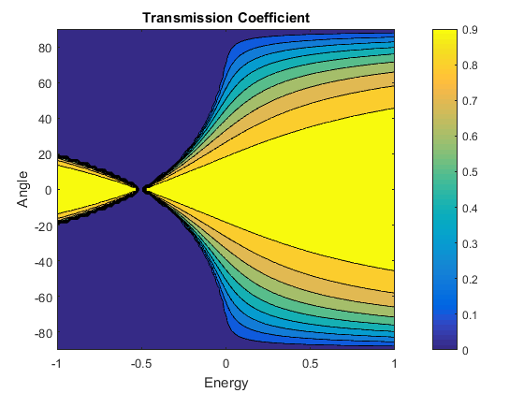
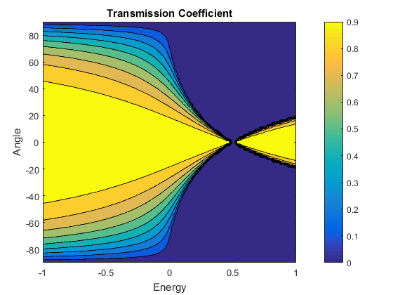
Interface Transmission Asymmetry
Introduction
Graphene CNN
Low-loss Diode
Diffusive Coupler
Tech. Limitations
Future Work
Left-to-Right
Right-to-Right
E₁ = 0.5 eV, E₂ =-0.5eV

Slide 39
Oblique PN junction model
Introduction
Graphene CNN
Low-loss Diode
Diffusive Coupler
Tech. Limitations
Future Work
Scattering smears the angular distribution and limits the backward-to-forward resistance ratio

Slide 40
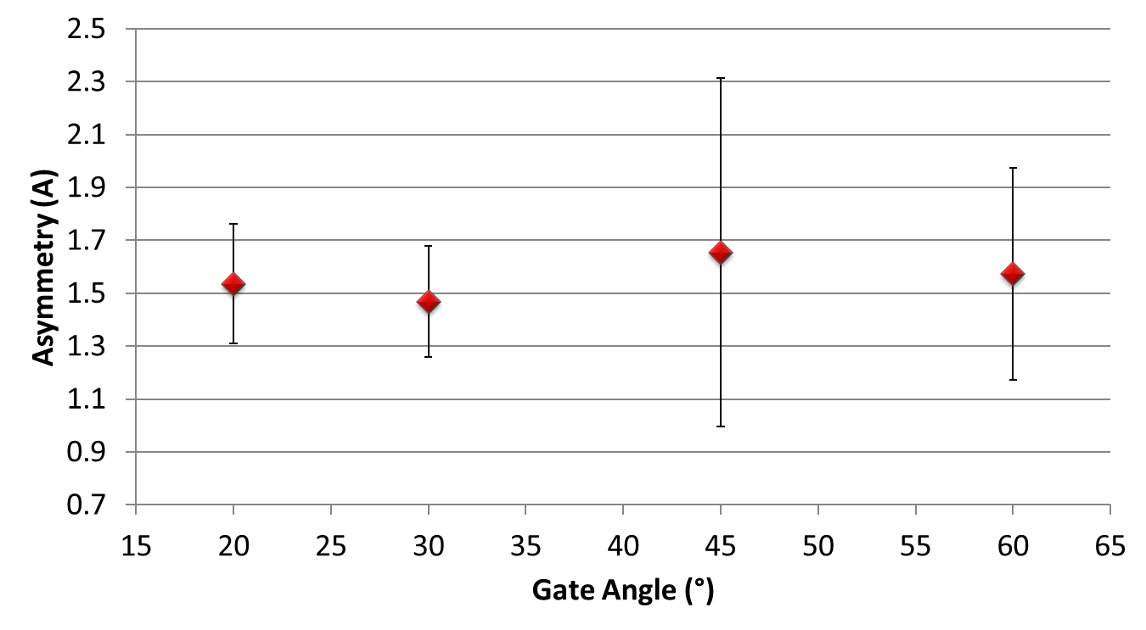
Measurement Results
Introduction
Graphene CNN
Low-loss Diode
Diffusive Coupler
Tech. Limitations
Future Work
A = I(V_{FWD})/I(V_{BWD})
Best reported Geometric Diode
Highest Graphene Diode Asymmetry reported to date!
Notes:
Whiskers are standard deviation and point is the mean

Slide 41
Conclusion
Introduction
Graphene CNN
Low-loss Diode
Diffusive Coupler
Tech. Limitations
Future Work
Geometric diodes show that exfoliated graphene is better than CVD graphene
Measurements show that CVD oblique incidence diodes outperform exfoliated geometric diodes
Asymmetry is still too low for practical devices
Scattering and lead resistance need to be reduced

Slide 42
Outline
Introduction
Graphene CNN
Low-loss Diode
Diffusive Coupler
Tech. Limitations
Future Work
All-Graphene Neuromorphic Computing
Low-loss Graphene Diodes
Current Coupling in Diffusive-Transport Graphene
Current Technological Limitations

Slide 43
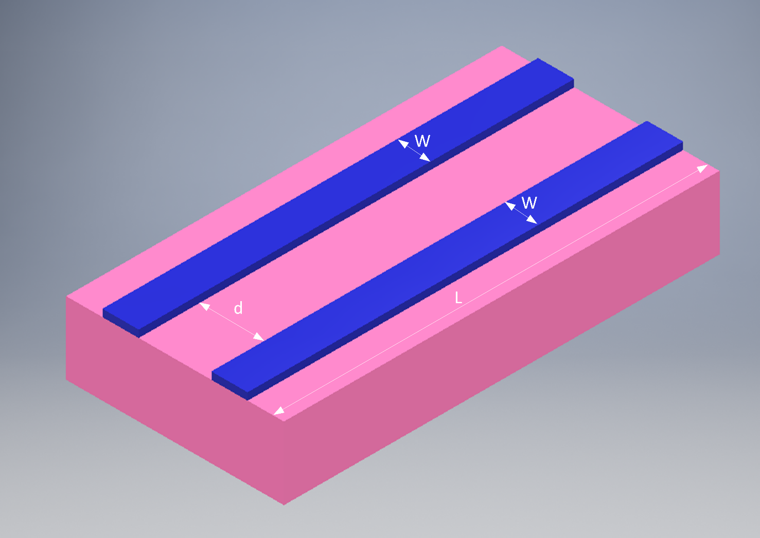
Graphene Coupler
Introduction
Graphene CNN
Low-loss Diode
Diffusive Coupler
Tech. Limitations
Future Work

Slide 44
Why study resistive coupling?
Introduction
Graphene CNN
Low-loss Diode
Diffusive Coupler
Tech. Limitations
Future Work
Ballistic-transport devices predicted to have periodic coupling coefficient like their optics counterparts
Diffusive-transport couplers never studied
Could they be useful?
How does diffusive transport affect the coupling coefficient?
Capacitive coupling and cross-talk have been thoroughly investigated, but no study of scaling limits in terms of resistive coupling

Slide 45
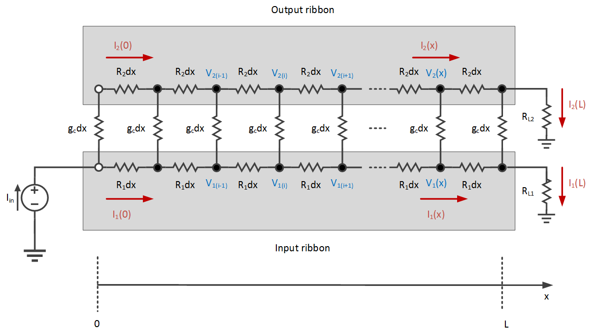
Electrical model of diffusive coupler
Introduction
Graphene CNN
Low-loss Diode
Diffusive Coupler
Tech. Limitations
Future Work
Notes:
Loss of phase information by scattering allows us to model coupling using a resistance
Sheet resistance of each branch assumed to be the same for simplicity
Process gradient can be assumed negligible if ribbons are not too far apart
Charge-puddles average out macroscopically
Coupling conductance per unit length obtained via Bardeen Transfer Hamiltonian (BTH)

Slide 46
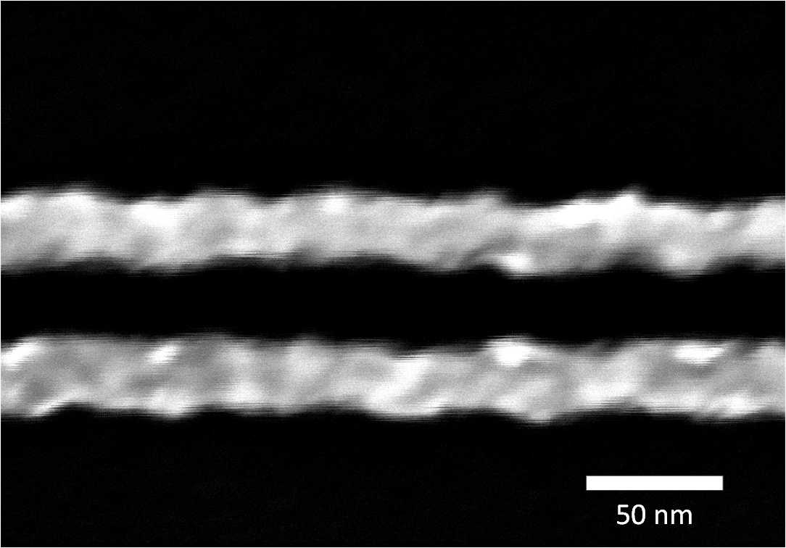
Is this model accurate?
Introduction
Graphene CNN
Low-loss Diode
Diffusive Coupler
Tech. Limitations
Future Work
Loss of phase information preserved
All distributed resistances should be random variables
Can be relaxed to first order models and when ribbon spacing is too wide relative to LER

Slide 47
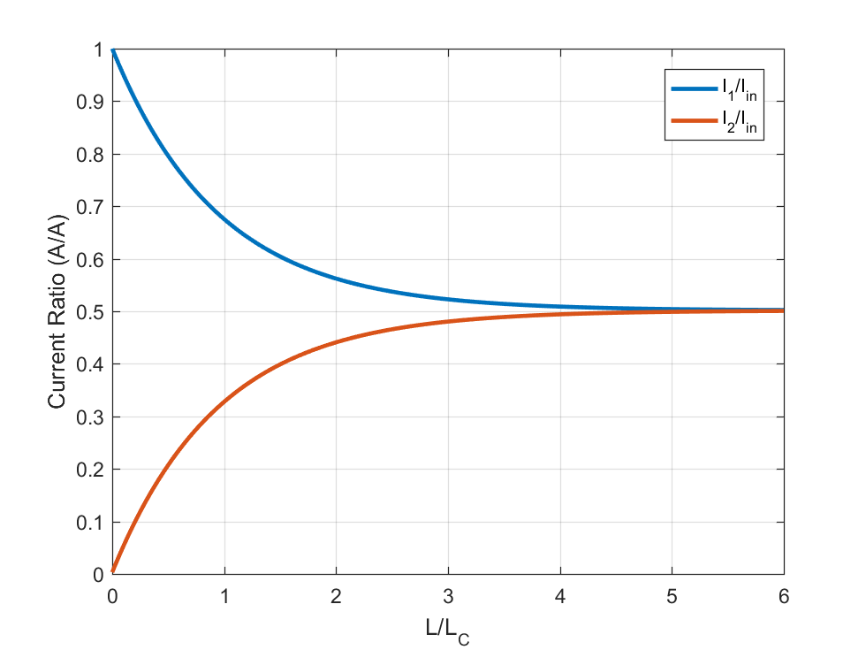
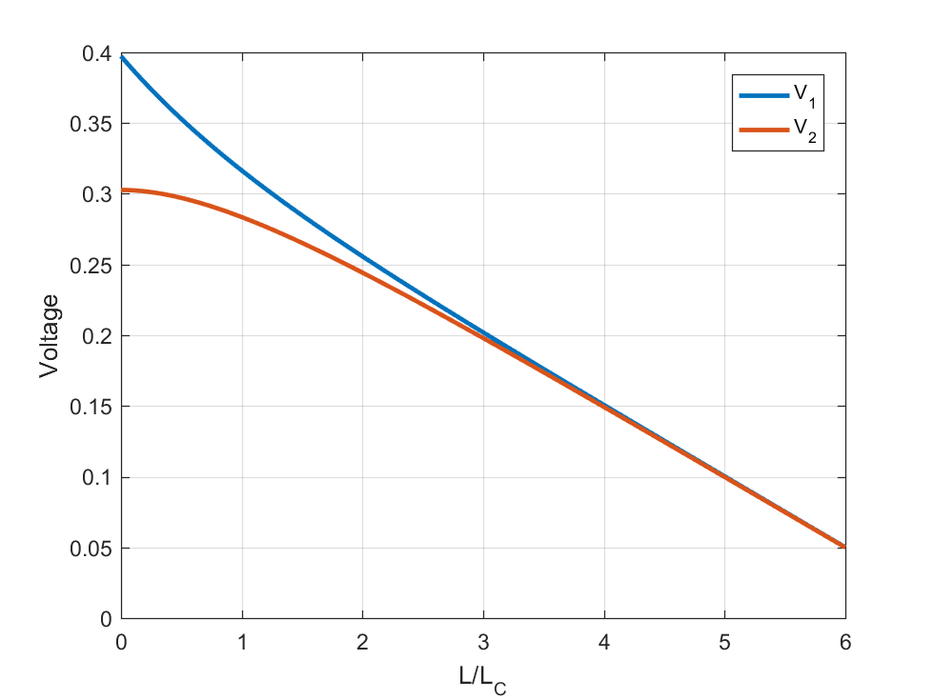
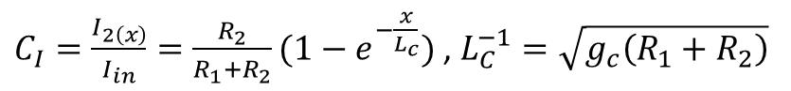
SPICE simulation results
Introduction
Graphene CNN
Low-loss Diode
Diffusive Coupler
Tech. Limitations
Future Work
R₁=R₂
$C_{I}=\frac{I_{2\left(x\right)}}{I_{in}}=\frac{R_{2}}{R_{1}+R_{2}}(1−e^{−\frac{x}{L_{c}}})$ , $L_{C}^{−1}=\sqrt{g_{c}\left(R_{1}+R_{2}\right)}$

Slide 48
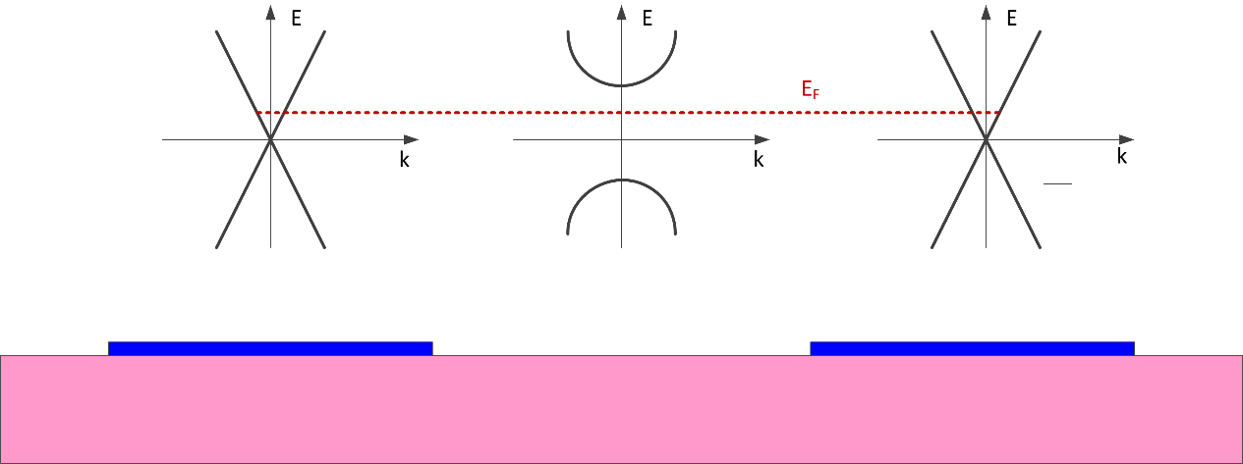
Coupling conductance estimation
Introduction
Graphene CNN
Low-loss Diode
Diffusive Coupler
Tech. Limitations
Future Work
Notes:
Angular spread of transmission coefficient is low

Slide 49



Coupling conductance results
Introduction
Graphene CNN
Low-loss Diode
Diffusive Coupler
Tech. Limitations
Future Work
$$g_{c}∝{\left(κe^{−κd}\right)}^{2}$$

Slide 50
Conclusion
Introduction
Graphene CNN
Low-loss Diode
Diffusive Coupler
Tech. Limitations
Future Work
Diffusive-transport couplers have an asymptotic coupling coefficient
Not periodic like ballistic-transport couplers
Resistive coupling not a concern for deeply scaled graphene ribbons
Coupling conductance is negligible for ligthographically-defined ribbons

Slide 51
Outline
Introduction
Graphene CNN
Low-loss Diode
Diffusive Coupler
Tech. Limitations
Future Work
All-Graphene Neuromorphic Computing
Low-loss Graphene Diodes
Current Coupling in Diffusive-Transport Graphene
Current Technological Limitations

Slide 52
Impact of Metal-Graphene Interface on Device Performance
Introduction
Graphene CNN
Low-loss Diode
Diffusive Coupler
Tech. Limitations
Future Work
Joule heating increases channel temperature increasing scattering and reducing mobility
Proper device design enhances graphene-metal thermal contact allowing heat to escape through the contact reducing the channel heating
Thermal contact optimization should not affect electrical contact resistance to prevent reduction in electrical device performance
D. Saha, X. Yu, M. Darwish, M. Jeong, J. Freedman, A. Gellman, J. Weldon and J. Malen, “Developing Superior Alloy Contacts Optimized for Electrical and Thermal Transport at Metal-Graphene Interfaces”, MRS Spring, April 2017

Slide 53
Contact Metal Choice
Introduction
Graphene CNN
Low-loss Diode
Diffusive Coupler
Tech. Limitations
Future Work
Ni and Pd are known to have the lowest electrical contact resistance to graphene
Compositionally Spread Alloy Film (CSAF) or Ni-Pd was evaporated on a blanket graphene film over 90 thermal SiO₂ and graphene-metal interface thermal conductance (G_{TH}) was evaluated FDTR (Frequency Dependent Thermal Reflectance)
All sample covered with Au transducer layer
Higher thermal interface conductance is desirable as it means more heat can flow across the metal contact rather than through the channel
D. Saha, X. Yu, M. Darwish, M. Jeong, J. Freedman, A. Gellman, J. Weldon and J. Malen, “Developing Superior Alloy Contacts Optimized for Electrical and Thermal Transport at Metal-Graphene Interfaces”, MRS Spring, April 2017

Slide 54

FDTR setup
Introduction
Graphene CNN
Low-loss Diode
Diffusive Coupler
Tech. Limitations
Future Work
J. Epstein, W. L. Ong, C. J. Bettinger, and J. A. Malen, “Temperature Dependent Thermal Conductivity and Thermal Interface Resistance of Pentacene Thin Films with Varying Morphology,” ACS Appl. Mater. Interfaces, vol. 8, no. 29, pp. 19168–19174, 2016.
Notes:
Pump changes temperature
Probe measures changes in reflectance due to heating, which modulates its CW signal
Phase variation vs frequency fitted to obtain surface conductance after fitting to multi-layer heat transfer model

Slide 55

Evaluated Metal-Graphene G_{TH}
Introduction
Graphene CNN
Low-loss Diode
Diffusive Coupler
Tech. Limitations
Future Work
Elemental metals lie in this range
D. Saha, X. Yu, M. Darwish, M. Jeong, J. Freedman, A. Gellman, J. Weldon and J. Malen, “Developing Superior Alloy Contacts Optimized for Electrical and Thermal Transport at Metal-Graphene Interfaces”, MRS Spring, April 2017
Notes:
Ni-Pd allow with ~10% Pd gives very large increase thermal interface conductance → More heat flows through the contact rather than chanel

Slide 56

Electrical Measurements
Introduction
Graphene CNN
Low-loss Diode
Diffusive Coupler
Tech. Limitations
Future Work
Currently another CSAF sample is being created with electrical and thermal measurements structures
Electrical: Linear TLM, Circular TLM, CBKR and 4-point probe
Thermal: Metal strips
Will the electrical contact resistance show the same trend?
Notes:
Linear Transfer Length Method
Circular Transmission Line Method

Slide 57

Stress in GFETs
Introduction
Graphene CNN
Low-loss Diode
Diffusive Coupler
Tech. Limitations
Future Work
Contacts anchor the graphene to the substrate
Graphene is single-atom thick, surrounded by materials of different thermal expansion coefficient
Highly prone to stress
α₁
Contact
Contact
Top Gate Oxide
Adhesion
Adhesion
α₂
Graphene
Bottom Gate Oxide
Silicon Substrate

Slide 58

Probing Stress in Graphene
Introduction
Graphene CNN
Low-loss Diode
Diffusive Coupler
Tech. Limitations
Future Work
2D Raman peak red shifts under tension
2D Peak FWHM function of both stress and charge fluctuations
2D peak splits under
Function of orientation, polarization and strain magnitude
Tension
Compression
M. Mohr, J. Maultzsch, and C. Thomsen, “Splitting of the Raman 2D band of graphene subjected to strain,” Phys. Rev. B, vol. 82, no. 20, p. 201409, Nov. 2010.
Notes:
Left/Right on the scale is more intuitive in the discussion over graphs.
Mention the 2D shift being an overtone of the breathing mode increasing the wavelength and hence causing red shift

Slide 59


Device Structure used in Strain Evaluation
Introduction
Graphene CNN
Low-loss Diode
Diffusive Coupler
Tech. Limitations
Future Work

Slide 60


Strain Evolution during GFET Fabrication
Introduction
Graphene CNN
Low-loss Diode
Diffusive Coupler
Tech. Limitations
Future Work
M. Darwish, D. Saha, J. Malen, and J. A. Weldon, “Processing-Induced Strain in Dual-Gated Graphene FETs”, in IEEE Nano, 2017.
Notes:
Single point left
Scan data right
ALD seems to anneal effect of stress by seed layer.

Slide 61
Impact of Developer Chemistry on Device Performance
Introduction
Graphene CNN
Low-loss Diode
Diffusive Coupler
Tech. Limitations
Future Work
Photoresist developer chemistry can contain Metal-Ion Containing (MIC) or be Metal-Ion Free (MIF)
Choice of developer chemistry is dictated by process compatibility and developer properties
Impact MIF and MIC developers on device performance evaluated using the constant mobility model

Slide 62


Dirac Point Shift
Introduction
Graphene CNN
Low-loss Diode
Diffusive Coupler
Tech. Limitations
Future Work
N=25
MIC
MIC
Notes:
The results for each developer are presented using box plots, Central marker for median, Box edges are 25 and 75 percentile edges, Whiskers extend to most extreme data points.
Hysteresis due to trapped interface charges screened by metla charges

Slide 63


Field-Effect Mobility and Charged-Impurity Concentration
Introduction
Graphene CNN
Low-loss Diode
Diffusive Coupler
Tech. Limitations
Future Work
N=25
MIC
MIC
Notes:
The results for each developer are presented using box plots, Central marker for median, Box edges are 25 and 75 percentile edges, Whiskers extend to most extreme data points.

Slide 64

Contact Resistance
Introduction
Graphene CNN
Low-loss Diode
Diffusive Coupler
Tech. Limitations
Future Work
N=25
MIC
Notes:
Large spread tells us about repeatability and interface quality

Slide 65

Mobility and Charged-Impurity Concentration
Introduction
Graphene CNN
Low-loss Diode
Diffusive Coupler
Tech. Limitations
Future Work
The mobility and charged-impurity concentration are inversely proportional
The relation between $μ$ and $n_{o}$ is given as: $μ=k\frac{q}{h}\left(\frac{1}{n_{o}}\right)$
The value of the proportionality constant has been evaluated theoretically to be $k≅165$

Slide 66


Mobility vs Charged-Impurity Concentration
Introduction
Graphene CNN
Low-loss Diode
Diffusive Coupler
Tech. Limitations
Future Work
$$μ≅4.24\frac{q}{{hn}_{o}}$$
M. Darwish, D. Saha, J. Malen, and J. A. Weldon, “A Comparison of the Impact of Metal - Ion Containing and Metal - Ion Free Photoresist Developers on Graphene Field - Effect Transistors,” in IEEE Nano, 2017.
Notes:
Mobility worst than predicted theoretically

Slide 67




Residual Photoresist on Graphene Channel
Notes:
Large residual in AZ Dev and AZ400K. Metal-Graphene interface certainly less resist, but confirms our prediction of the interface quality.

Slide 68
Conclusion
Metal-Graphene electrical and thermal interface co-optimization can be rapidly evaluated using CSAF films
Ni-Pd films very promising
MIC developers degrade mobility due to charged-impurity scattering increase, but reduce interface-trapped charge hysteresis
Mobility degradation due to charged-impurity scattering is worse than theoretically predicted
Some resists leave considerable residual over graphene, causing large spread in reported contact resistance and interface-dependent phenomena

Slide 69

What’s next?
Introduction
Graphene CNN
Low-loss Diode
Diffusive Coupler
Tech. Limitations
Future Work

Slide 70

Future Work – Contact Engineering
Introduction
Graphene CNN
Low-loss Diode
Diffusive Coupler
Tech. Limitations
Future Work
Co-optimization of electrical and thermal interface contact resistance by alloying
CSAF films allow rapid evaluation and fine-tuning of contact alloys
Impact of adhesion layer evaluated using partial-coverage films

Slide 71
Future Work – Graphene leads for 2D materials
Introduction
Graphene CNN
Low-loss Diode
Diffusive Coupler
Tech. Limitations
Future Work
2D materials are doped by contacts
Integration of different metals for different device doping type is limiting, if possible
Graphene can act as an intermediate lead between the metal and 2D semiconductor to alleviate contact doping
Can be combined with alloyed metal-graphene contacts
Notes:
Graphene gets doped – doesn’t matter due to e-h symmetry but screens 2D semiconducting channel from doping

Slide 72
Future Work – Oblique diodes using hBN/G/hBN heterostructure
Introduction
Graphene CNN
Low-loss Diode
Diffusive Coupler
Tech. Limitations
Future Work
Exfoliated graphene between hBN flakes has low scattering
Mean free paths (MFP) for up to a micron at room temperature
Oblique-incidence diodes fabricated using hBN/G/hBN heterostructure will have reduced scattering and higher asymmetry
The use of edge contacts allows reducing the parasitic contact resistance considerably

Slide 73
Future Work – CVD hBN with CVD graphene
Introduction
Graphene CNN
Low-loss Diode
Diffusive Coupler
Tech. Limitations
Future Work
hBN is the optimal substrate for graphene
Combining CVD hBN with CVD graphene enables wafer-level integration of high performance graphene devices
CVD of hBN has been demonstrated, but transfer along with CVD graphene is yet to be explored

Slide 74
Acknowledgements (1)
Prof. Jeffrey A. Weldon.
Prof. Larry Pileggi
Prof. Randall Feenstra
Prof. Eric Pop (Stanford University)

Slide 75
Acknowledgements (1)
Prof. Andrew Gellman
Prof. Jonathan Malen
Prof. Ben Hunt
Prof. Tzahi Cohen-Karni

Slide 76
Acknowledgments (2)
Dr. Mohamed Abdelmoula
Dr. Doron Naveh
Dr. Mathew Moneck
Nanofab Staff: Mark Weiler, Norman Gottron, Mason Risley, James Rosvanis
Ex. Nanofab Staff: Carsen Kline and Chris Bowman

Slide 77
Acknowledgments (3)
Prof. Jelena Kovačević
Dipanjan Saha
Ning Wang (Stanford University)
Dr. Sergio de la Barrera
Devashish Goplan
Xiaoxiao Yu

Slide 78

Acknowledgments (4)
David Bromberg, Tom Jackson, Jeff Zayas, Sean Yen, Omer Ozdemir, Yunlu Li, Isen Ozalp, Yunus Kesim, Sungho Kim, Nail Etkin “LL” Can Akkaya, Burac Erbagci, Luca Colombo, Mats Forssell, MaryBeth Galanko, Ashwati Krishnan, Metin Guney, Andrew Ong, Cheng-Ming Chow, Ekin Sumbul, Ahmed Abdelgawad, Usama Zaghloul, Ahmed Khairi, Ahmed Hussein, Mazen Soliman, Mohamed Mahmoud, Khaled El-Galaind, Ahmed Hefny and Waleed Ammar
Dr. Amani Attia
Dr. Ashraf Taha
This work was supported in part by Systems on Nanoscale Information fabriCs (SONIC), one of the six SRC STARnet Centers, sponsored by MARCO and DARPA

Slide 79

Acknowledgments (5)
My Father, Omar Abdulaziz
My Mother, Mariam
My Sister, Mennatullah
My Son, Bilal
My Wife and support, Mai

Slide 80

Questions?

Slide 81
Fabrication Steps (1): Contact photolithography
Beyond-CMOS
Graphene CNN
RG Mux Logic
Graphene Properties
(a) Positive photoresist (S1805) and lift-off layer (LOR3A) spin and bake
(b) Exposure and development in CD26 (TMAH-based MIF developer prevents graphene doping)

Slide 82

Fabrication Steps (1): Contact photolithography
Beyond-CMOS
Graphene CNN
RG Mux Logic
Graphene Properties

Slide 83
Fabrication Steps (2): Contact deposition and lift-off
Beyond-CMOS
Graphene CNN
RG Mux Logic
Graphene Properties
(a) Evaporation of contact metal stack (Ti/Pd 1.5/40 nm at a rate < 0.3 Å/sec)
(b) Lift-off in a dedicated Microposit 1165 remover at 70 °C to prevent contamination

Slide 84

Fabrication Steps (2): Contact deposition and lift-off
Beyond-CMOS
Graphene CNN
RG Mux Logic
Graphene Properties

Slide 85
Fabrication Steps (3): Channel Etch Mask Photolithography
Beyond-CMOS
Graphene CNN
RG Mux Logic
Graphene Properties
(a) Positive photoresist (S1805) and lift-off layer (LOR3A) spin and bake
(b) Exposure and development in CD26 (TMAH-based MIF developer prevents graphene doping)

Slide 86
Fabrication Steps (4): Channel Definition using RIE
Beyond-CMOS
Graphene CNN
RG Mux Logic
Graphene Properties
(a) Etch the exposed graphene in O₂ plasma (20 W for 1 minute at 10 mTorr)
(b) Etch mask removal in a dedicated Microposit 1165 remover at 70 °C to prevent contamination

Slide 87

Fabrication Steps (3): Channel Etch Mask Photolithography
Beyond-CMOS
Graphene CNN
RG Mux Logic
Graphene Properties

Slide 88
Fabrication Steps (5): Top oxide seed layer and oxide deposition
Beyond-CMOS
Graphene CNN
RG Mux Logic
Graphene Properties
(a) Evaporation of 1.5 nm of Al to act as a seed layer for ALD as non-functionalized ALD reacts only with graphene edges. 1.5 nm of Al are fully oxidized in air (Native Al oxide is 2.5 nm thick)
(b) ALD of Al₂O₃ at 150 °C to finish the top gate oxide deposition

Slide 89
Fabrication Steps (6): Top gate e-beam lithography
Beyond-CMOS
Graphene CNN
RG Mux Logic
Graphene Properties
(a) Positive e-beam resist (PMMA A7) and spin and bake beyond glass transition temperature
(b) Exposure and development (1:3 MIBK:IPA developer) of top gate electrodes

Slide 90
Fabrication Steps (7): Top gate deposition
Beyond-CMOS
Graphene CNN
RG Mux Logic
Graphene Properties
(a) Evaporation of top gate metal
(b) Lift-off of top gate metal in a dedicated acetone bath

Slide 91

Fabrication Steps (7): Top gate deposition

